Slide 1

Fruit punch !
A brain training game

Slide 2
Introductions
Nikash CHEKURI
COO
13 years old
I like to code in Python
Gokul MENON
Head of Operations
14 years old
I like to code in C++
Jay Williams
CEO
14 years old
I like to code in node
Shaquile
Quality Assurance Manager
12 years old
I like to write HTML
Rory SHARP
Alternative Development Manager
13 years old
I like to code in Python

Slide 3
Why?

Slide 4
Demo
-Jay
About 30 seconds until everything breaks ;)
IT ALL BROKE

Slide 5
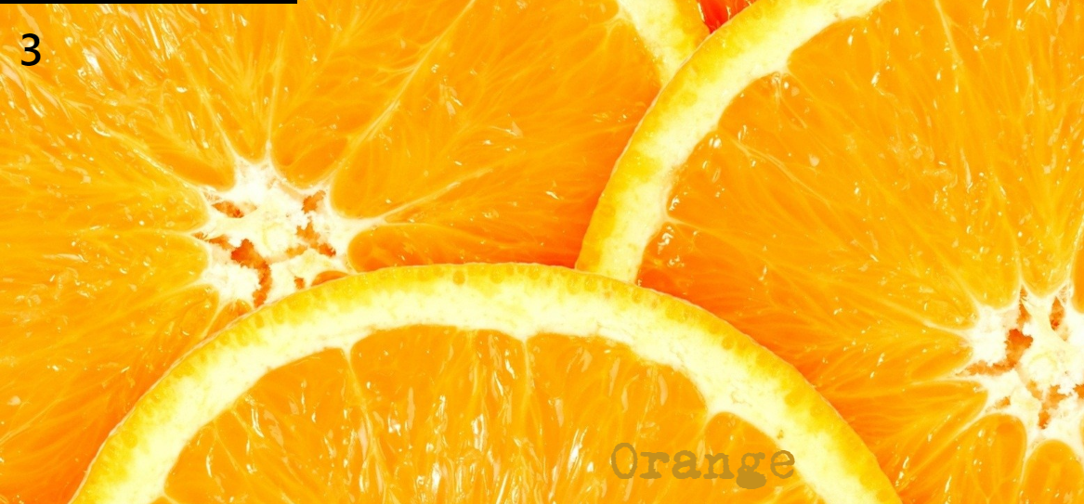
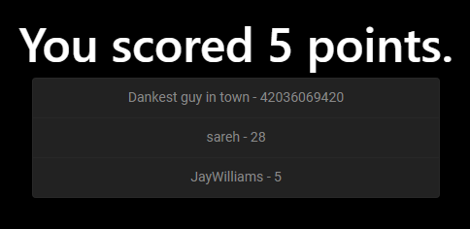
IT ALL BROKE
Enjoy these pictures instead

Slide 6








Development Process
NIKASH
IDEATION
DEVELOPMENT
TESTING

Slide 7
STATISICS

Slide 8
STATISICS
367
Lines of code, as of
v1.0.0:

Slide 9
RORY TALKS ABOUT
PYTHON
version

Slide 10

AMBITIONS
Engaging
Educational

Slide 11
CONCLUSION

Slide 12
Questions?

Slide 13
Thanks for watching
Clone us @ github:
codingJWilliams/BBCInventathonNode

